Slide 1

Java Project
Airline Reservation
Project Name: KPA airlines

Slide 2

Abstract:-
The Flight Booking System is a Java-based application designed to facilitate flight reservations and management. It provides an efficient and user-friendly platform for passengers to search for available flights, book tickets, and manage their reservations. The goal of this project is to provide the proper registration process to book the flight with easy procedure.
Key Features:
User Registration and Login:
-> Passengers can create accounts, log in, and access personalized features.
-> Secure authentication ensures data privacy.
Flight Search and Booking:
-> Passengers can search for flights based on criteria such as origin, destination,date
-> Available flights are displayed along with relevant details (e.g. time, duration,)
-> Passengers can select flights, choose seats, and make reservations.
Seat Management:
-> The system tracks seat availability for each flight.
-> Passengers can view seat maps and select preferred seats during booking.

Slide 3

Payment Gateway Integration:
-> Secure payment processing for ticket purchases.
-> Integration with payment gateways (e.g., credit card, online banking).
Booking Confirmation and E-Tickets:
-> Passengers receive booking confirmation emails with e-ticket details.
-> E-tickets serve as boarding passes during check-in.

Slide 4

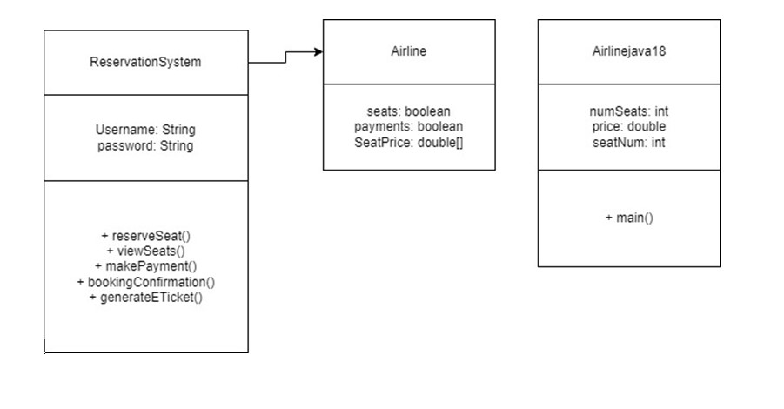
Class Diagram:-

Slide 5

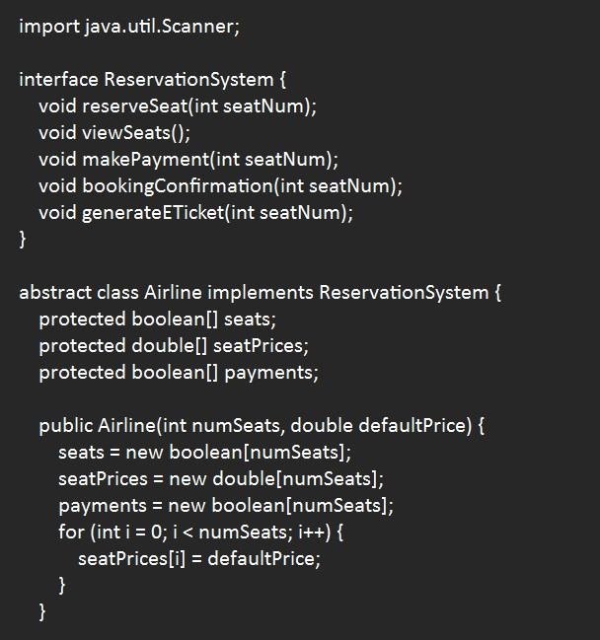
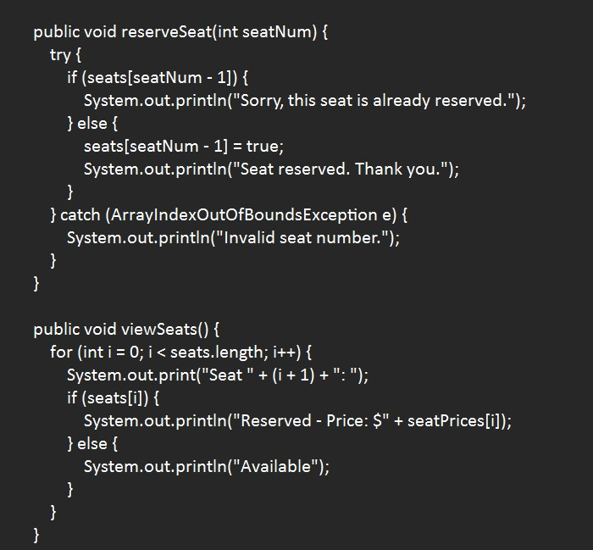
Code:-

Slide 6
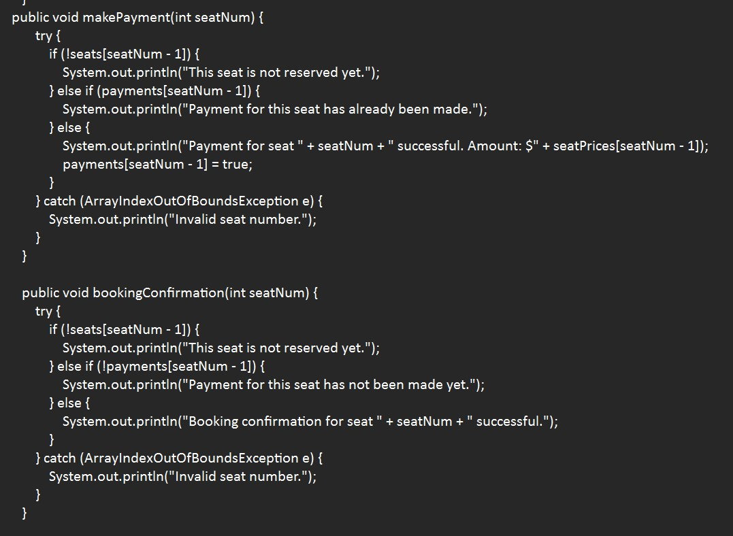

Slide 7
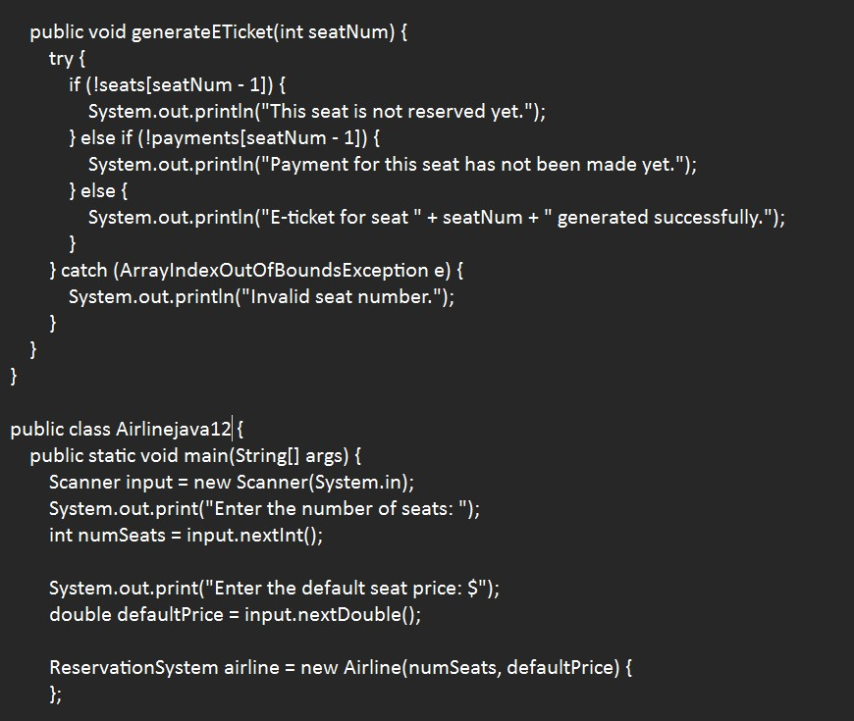

Slide 8
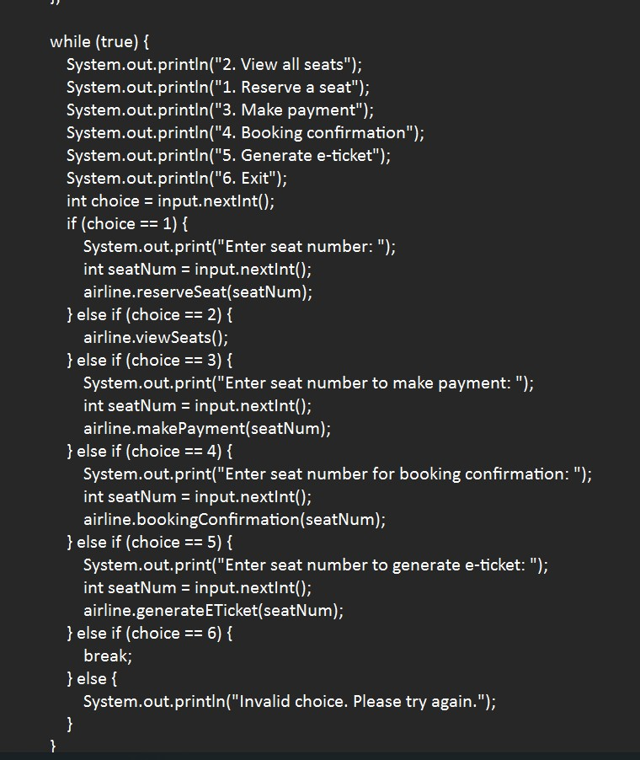
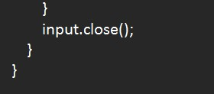

Slide 9
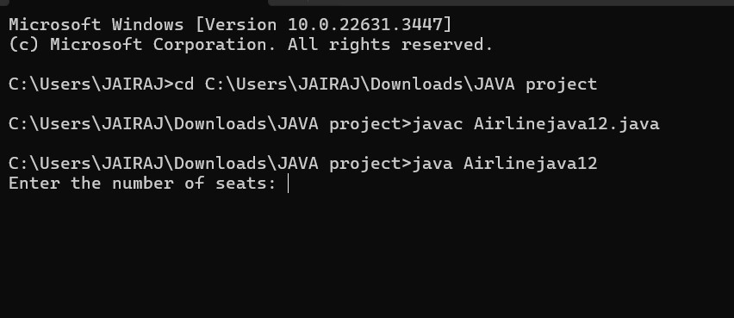
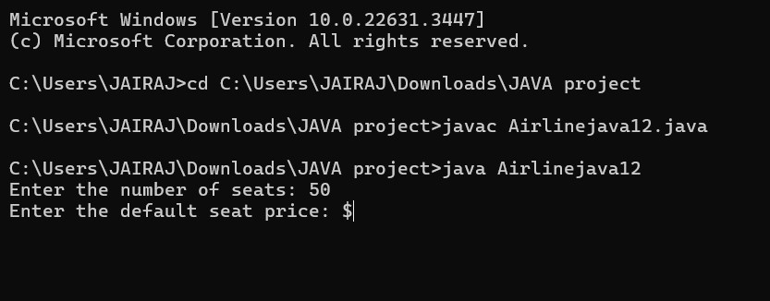
Output:-

Slide 10
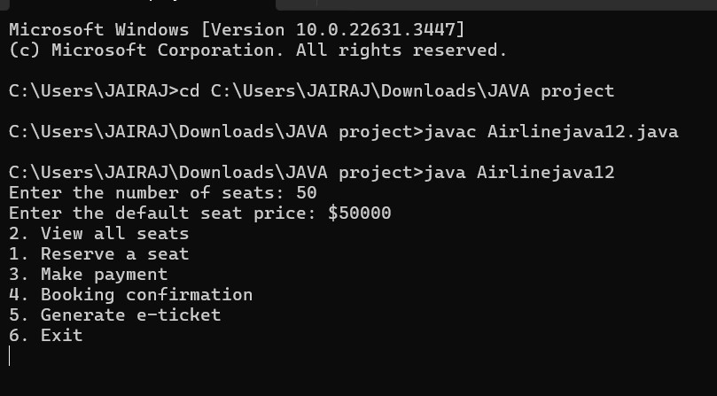
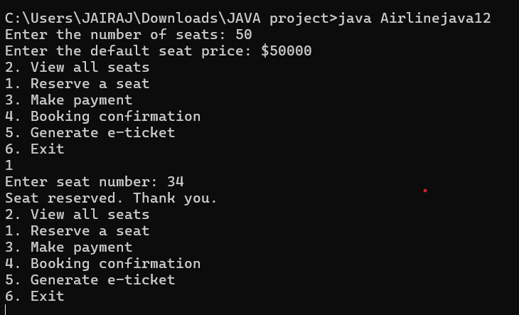

Slide 11
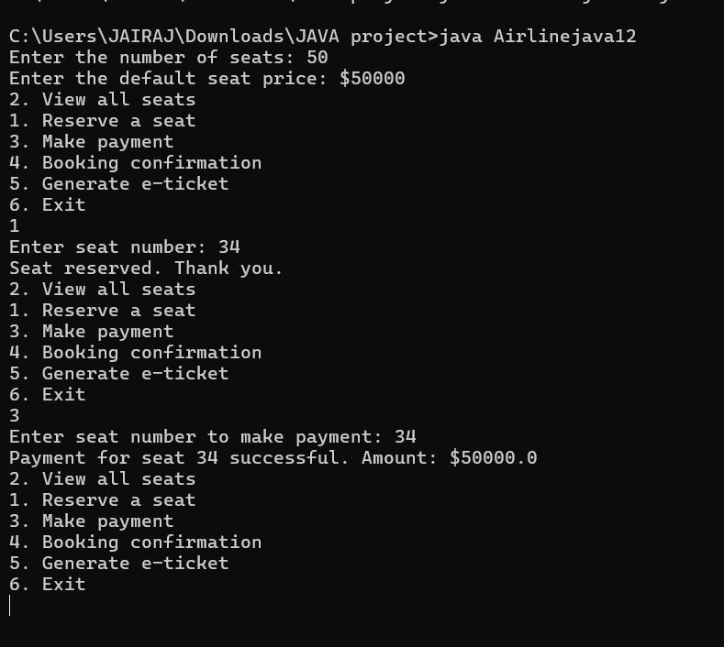

Slide 12
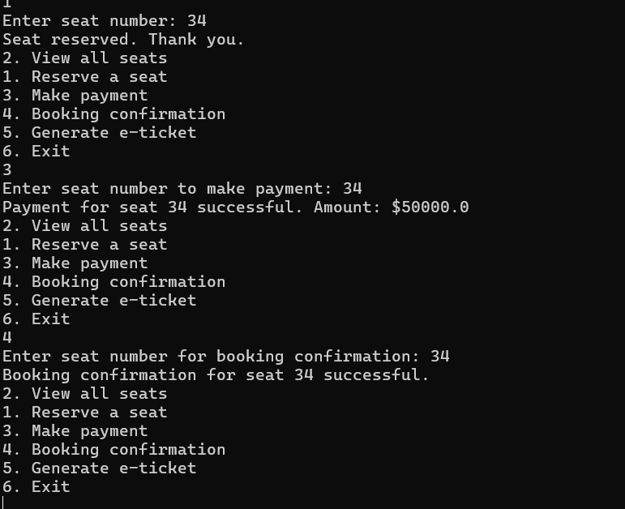

Slide 13
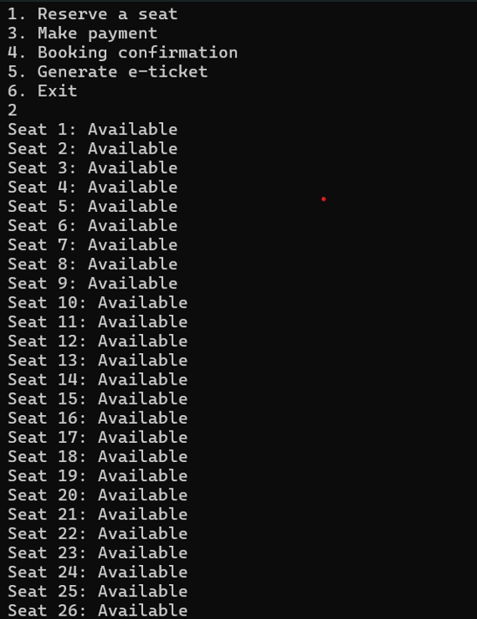
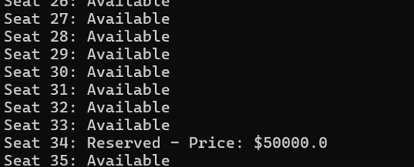

Slide 14
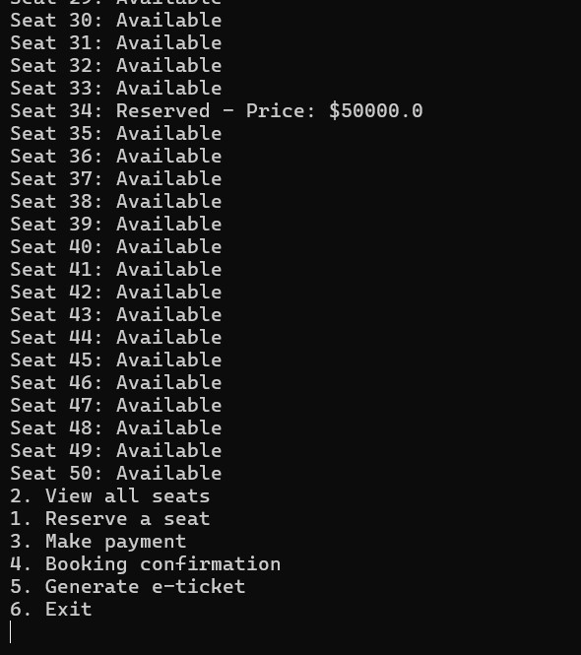

Slide 15

Conclusion:-
Overall, this program provides a basic framework for an airline reservation system. It allows users to interactively reserve seats, make payments, confirm bookings, and generate e-tickets. However, there are areas for improvement such as error handling, input validation, and potentially adding more advanced features like seat selection, user authentication, or integration with a database. Additionally, the code could benefit from further abstraction and modularization to enhance its maintainability and extensibility.

